Slide 1
Chapter 1
Lecture 5+6
Week 2
Ms. Nazia Shahzadi

Slide 2
Agenda
Operating-System Operations
  Direct Memory Access
  Computer System Architecture
  Symmetric and Asymmetric systems
  User and Kernel Modes

Slide 3
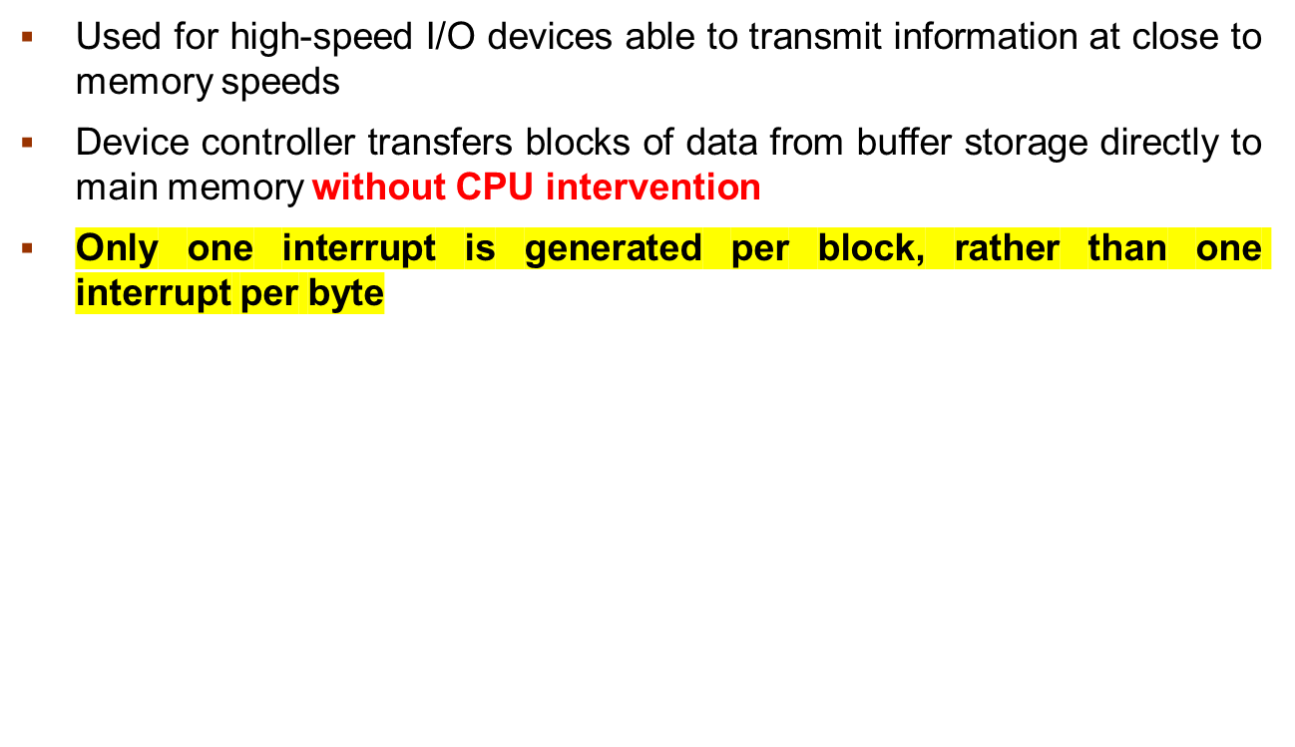
Direct Memory Access

Slide 4




How DMA Works?
I/O Devices
Memory
DMA-Controller
HRQ
HLDA
CPU
How a Modern Computer (DMA) Works?

Slide 5
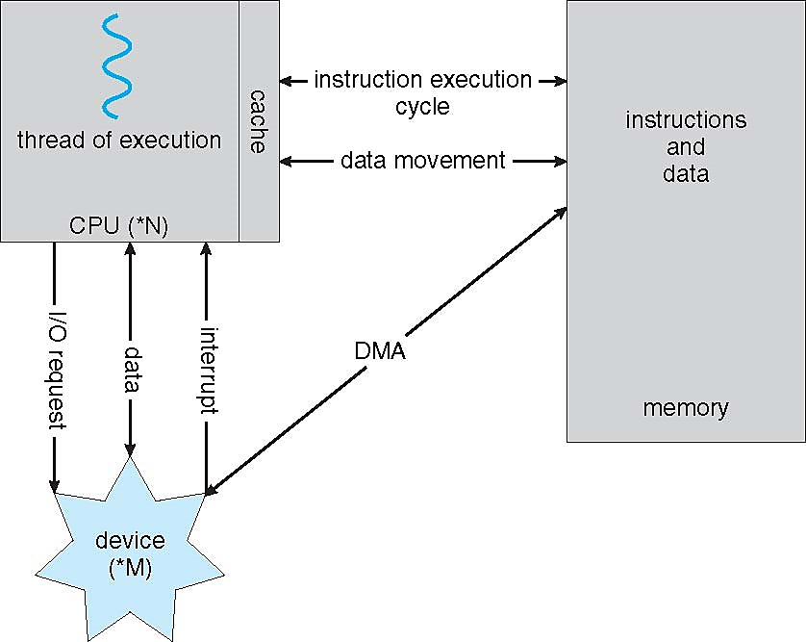
How a Modern Computer Works
How a Modern Computer Works?

Slide 6
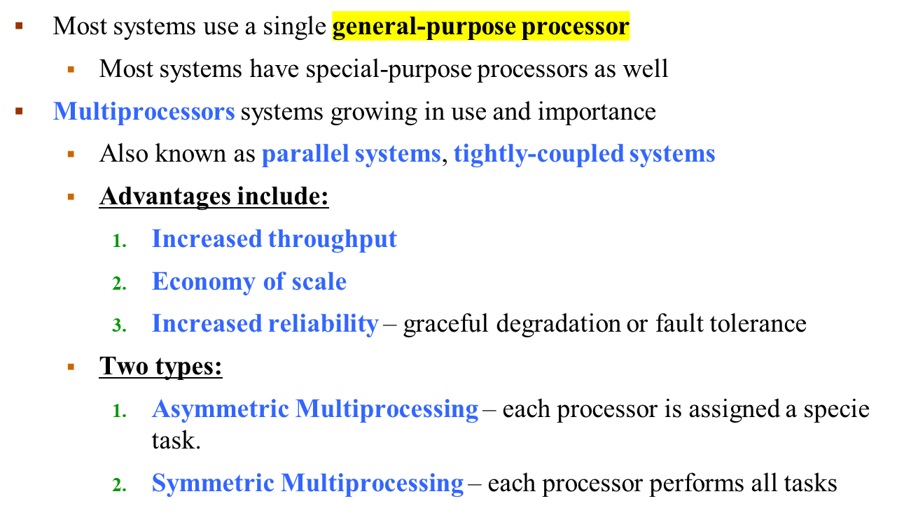
Computer-System Architecture

Slide 7
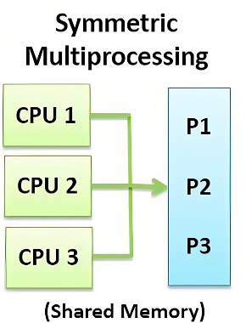
Symmetric Multiprocessing Architecture

Slide 8
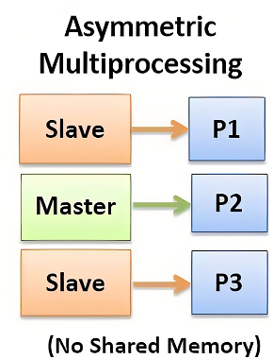
Asymmetric MP
Multi-chip and multicore
Systems containing all chips
  Chassis containing multiple separate systems

Slide 9
Clustered Systems
Like multiprocessor systems, but multiple systems working together
  Usually sharing storage via a storage-area network (SAN)
  Provides a high-availability service that survives failures
    Asymmetric clustering has one machine working
    Symmetric clustering has multiple nodes running applications, monitoring each other
  Some clusters are for high-performance computing (HPC)
    Applications must be written to use parallelization

Slide 10

Clustered Systems

Slide 11
Operating System Structure
Multiprogramming (Batch system) needed for efficiency
  Single user cannot keep CPU and I/O devices busy at all times
  Multiprogramming organizes jobs (code and data) so CPU always has one to execute
  A subset of total jobs in system is kept in memory
  One job selected and run via job scheduling
  When it has to wait (for I/O for example), OS switches to another job

Slide 12

Memory Layout for Multiprogrammed System

Slide 13
Operating System Structure
Timesharing (multitasking) is a logical extension in which the CPU switches jobs so frequently that users can interact with each job while it is running, creating interactive computing
  Response time should be < 1 second
  Each user has at least one program executing in the memory process
  If several jobs ready to run at the same time  CPU scheduling
  If processes don’t fit in memory, swapping moves them in and out to run

Slide 14
Operating-System Operations
Dual-mode operation allows OS to protect itself and other system components
  User mode and kernel mode
  Mode bit provided by hardware
    Provides ability to distinguish when system is running user code or kernel code
    Some instructions designated as privileged, only executable in kernel mode
    System call changes mode to kernel, return from call resets it to user

Slide 15
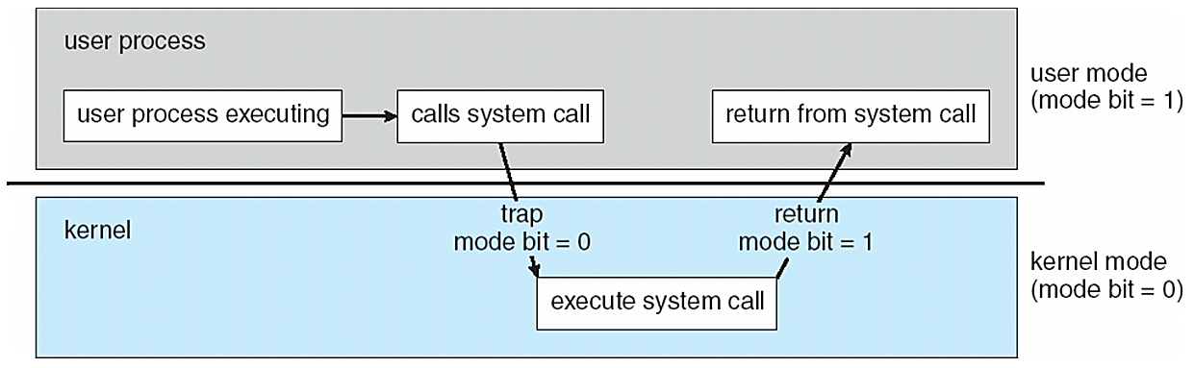
Transition from User to Kernel Mode
Fig: User and Kernel Mode

Slide 16
Transition from User to Kernel Mode
Timer to prevent infinite loop / process hogging resources
  Timer is set to interrupt the computer after some time period
  Keep a counter that is decremented by the physical clock.
  Operating system set the counter (privileged instruction)
  When counter zero generate an interrupt
  Set up before scheduling process to regain control or terminate program that exceeds allotted time

Slide 17

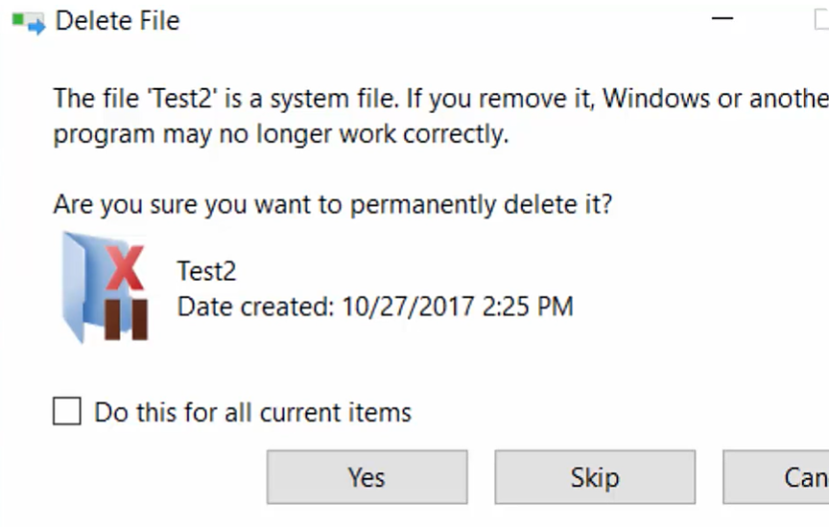
Errors generated by Kernel Mode

Slide 18
End of Lecture 5+6

